Slide 1
Project Springwater
C walker, c boucher, c cooper, d woodward,
t Stacey, a butcher, j forster & G Westwater

Slide 2

Why are we here?
OPS: Order Placement System
Customer Orders
Web Front End
WOTS: Warehouse Order Tracking System
Add Orders to Queue
Retrieve Order Statuses

Slide 3
As a visitor I want to be able to enter my details so I can become a customer
As a visitor I should be able to browse though a list of products
As a customer I want to be able to check my credit
As a customer I want to be able to place an order for the items in my basket
As an inventory manager I want to see the daily stock report
As an inventory manager I want to be able to make purchase orders of low and new stock lines

Slide 4
Database Structure

Slide 5
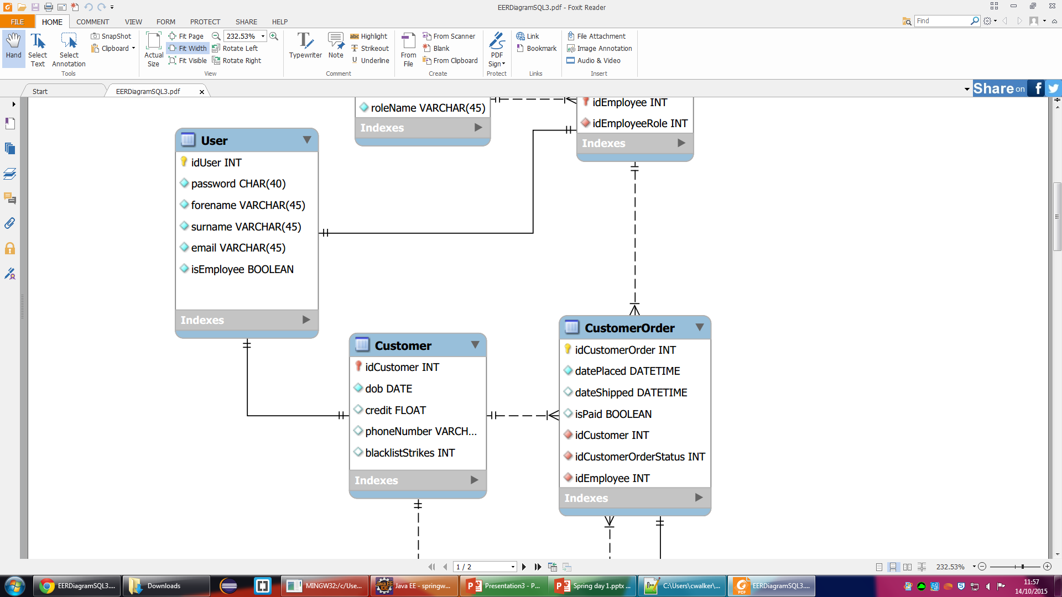
As a visitor I want to be able to enter my details so I can become a customer
Visitor
Customer -
idUser
First Name
Last Name
Email
Password
DOB
Phone Number

Slide 6
MySQL + Mongo DB

Slide 7
System Design

Slide 8
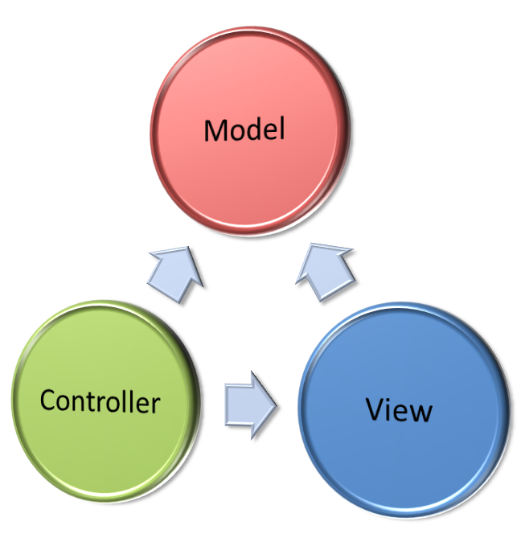
Design Patterns
MVC
Model
View
Controller
Objects First

Slide 9
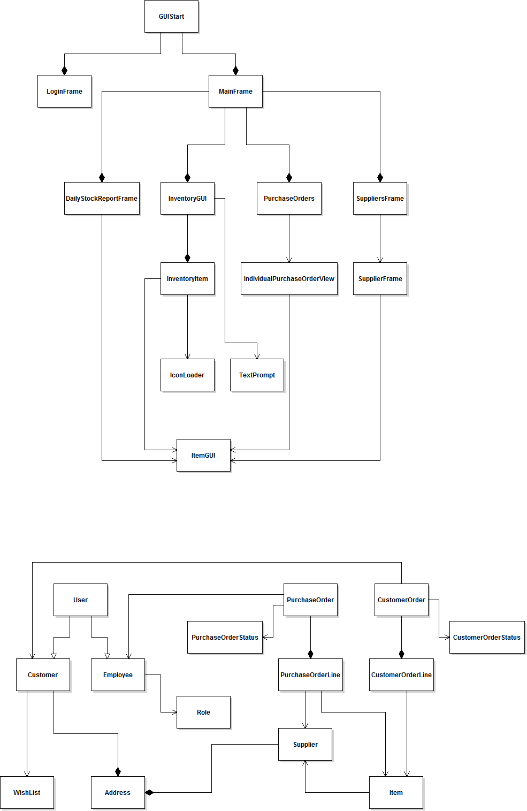
Class Diagrams

Slide 10
Live Demo
Java desktop app & HTML web app

